Slide 1
Sprocket Central Pty Ltd
Data analytics approach
Amit Sharma

Slide 2
Agenda
Note: The data and information presented in this document are based on a hypothetical scenario and client. This document is intended solely for the purposes of the KPMG Virtual Internship.
Introduction
Data Exploration
Model Development
Interpretation
Presentation Title

Slide 3
Note: The data and information presented in this document are based on a hypothetical scenario and client. This document is intended solely for the purposes of the KPMG Virtual Internship.
Introduction
Recognize and Suggest High-Value Customers
Problem Statement
Analytical Approach
Sprocket Central specializes in high-quality bikes and accessories, aiming to expand its market reach and boost sales.
The team is focused on analyzing customer data to target those with the highest potential for long-term value.
By leveraging insights, Sprocket Central will implement personalized campaigns to maximize customer engagement and drive sustainable growth.
Analysis of bike-related purchases over the past three years highlights gender-based buying patterns.
Age distribution plays a crucial role in maximizing profitability, helping refine target demographics.
Classifying customers based on purchasing behavior enables precise marketing strategies.
State-wise car ownership data provides insights into potential market opportunities.
Understanding the correlation between wealth segments and age helps tailor product offerings.
Identifying key industries contributing to bike-related purchases and overall profits enhances targeted outreach.

Slide 4
Note: The data and information presented in this document are based on a hypothetical scenario and client. This document is intended solely for the purposes of the KPMG Virtual Internship.
Data Exploration
Issues in Data Quality Rectified
 | Accuracy | Completeness | Consistency | Validity | Relevance | Currency
Customer Demographic | DOB: One incorrect entry detected. Age data missing | Customer ID is incomplete. Job Title, Last Name, and Tenure fields contain missing data. | Gender: Inconsistencies detected. | Default: Invalid | Default: Not relevant, deleted | Deceased customer filtered out
Customer Address |  | Customer ID is incomplete | State: Inconsistence | List Price, Product First Sold Date: Wrong Format
Transactions | Profit: missing | Customer ID is incomplete Online orders, Brands contain blanks |  |  | Cancelled status order filtered out

Slide 5
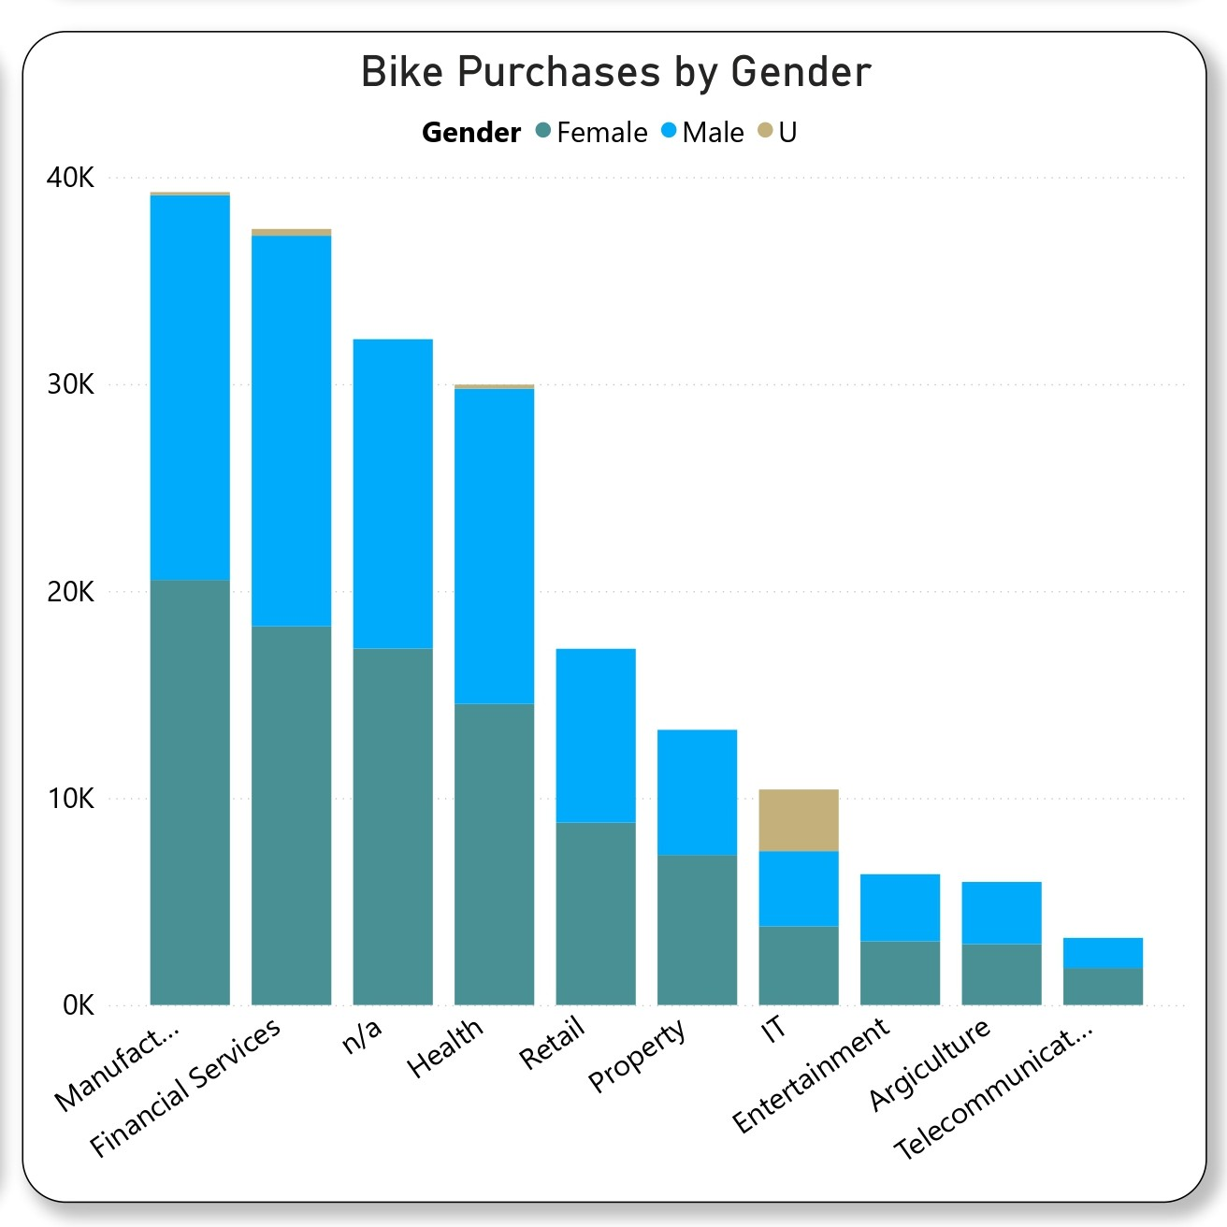
Note: The data and information presented in this document are based on a hypothetical scenario and client. This document is intended solely for the purposes of the KPMG Virtual Internship.
Data Exploration
Over the past three years, females led bike-related purchases with 98,277, surpassing males (93,392) and unidentified buyers (3,659).
Females in the manufacturing sector accounted for 10.51% of total bike-related purchases.
Targeting females in the manufacturing industry presents a key opportunity for maximizing engagement and sales.

Slide 6
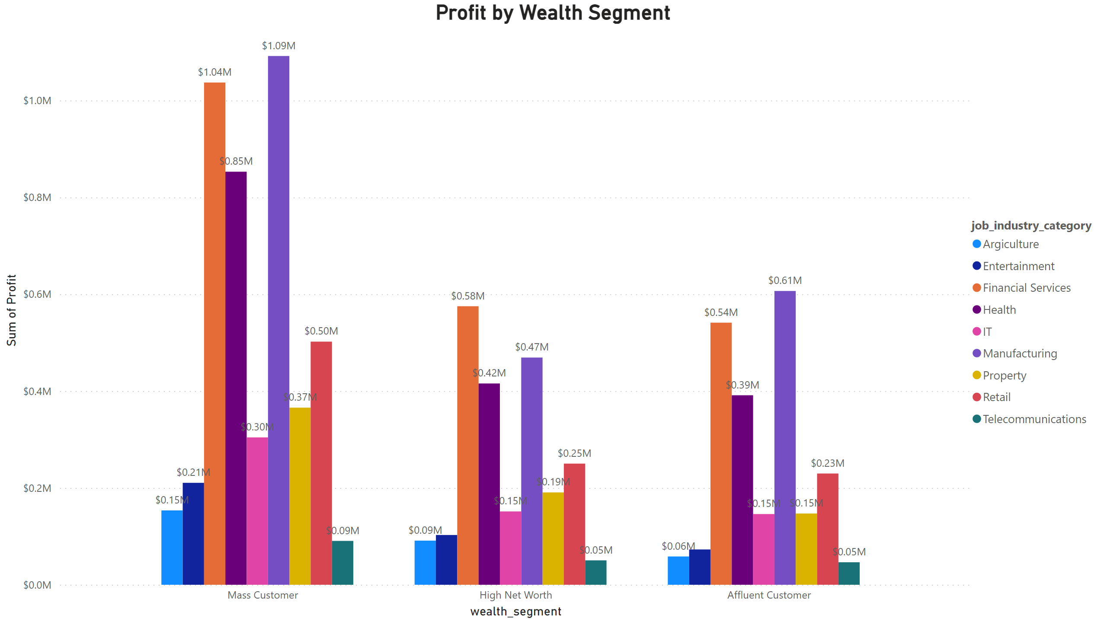
Note: The data and information presented in this document are based on a hypothetical scenario and client. This document is intended solely for the purposes of the KPMG Virtual Internship.
Data Exploration
Mass Customers generated the highest total profit of $4.61M, followed by High-Net-Worth Customers at $2.30M and Affluent Customers at $2.24M.
Manufacturing contributed 23.7% of the total profit.
The top industries generating the most profit are Manufacturing, Financial Services, and Health, reflecting customer preferences for city-based transportation solutions like bikes.

Slide 7
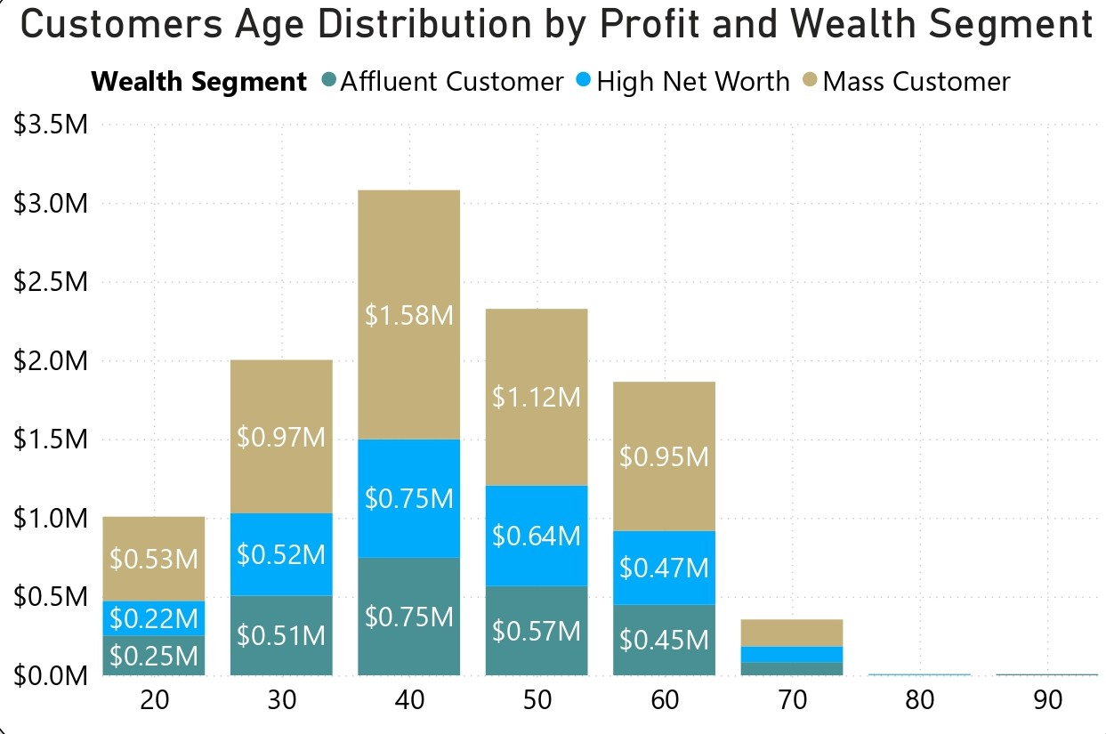
Note: The data and information presented in this document are based on a hypothetical scenario and client. This document is intended solely for the purposes of the KPMG Virtual Internship.
Data Exploration
Mass Customers generated the highest profit at $5.33M, followed by High-Net-Worth Customers at $2.71M and Affluent Customers at $2.61M.
The 40–50 age group contributed 15.96% of the total profit.
Mass Customers aged 40–50 are a significant profit driver, outperforming other age groups.

Slide 8
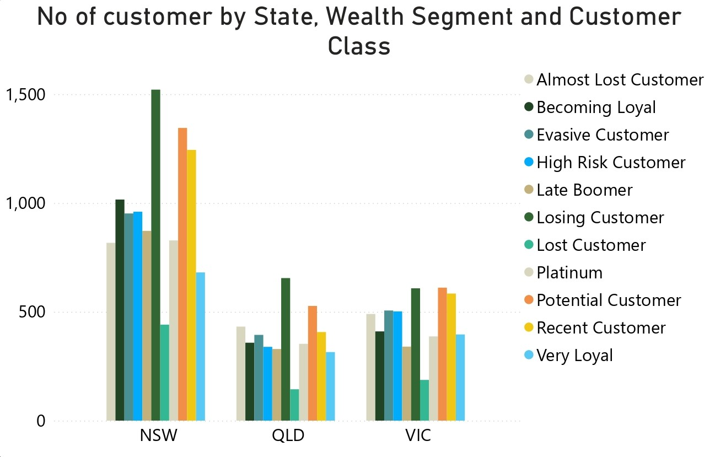
Note: The data and information presented in this document are based on a hypothetical scenario and client. This document is intended solely for the purposes of the KPMG Virtual Internship.
Data Exploration
NSW, QLD, and VIC present significant potential markets due to a high number of new customers without cars.
NSW stands out as a key opportunity, with an equal number of customers owning cars and not owning cars.

Slide 9
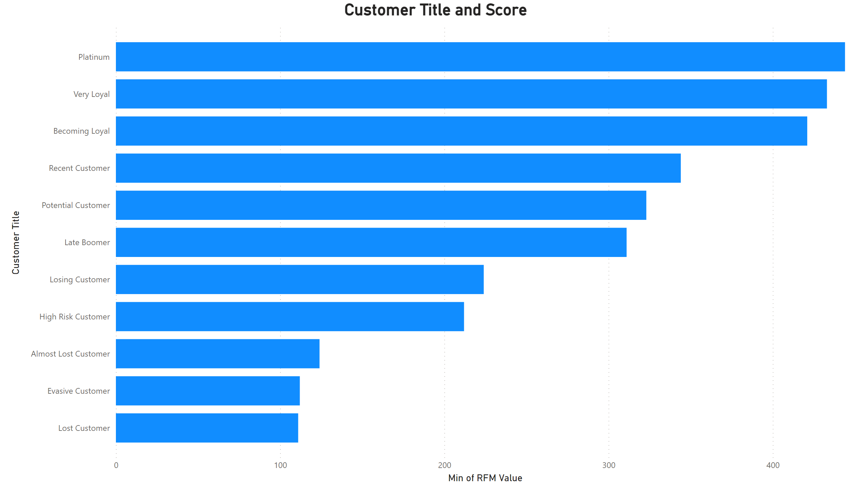
Note: The data and information presented in this document are based on a hypothetical scenario and client. This document is intended solely for the purposes of the KPMG Virtual Internship.
Data Modelling
RFM (Recency, Frequency, Monetary value) analysis provides businesses with valuable insights into customer segments, enabling data-driven marketing strategies.
It helps identify high-value customers for targeted promotions, re-engage inactive customers, and personalize communication based on individual behavior.

Slide 10
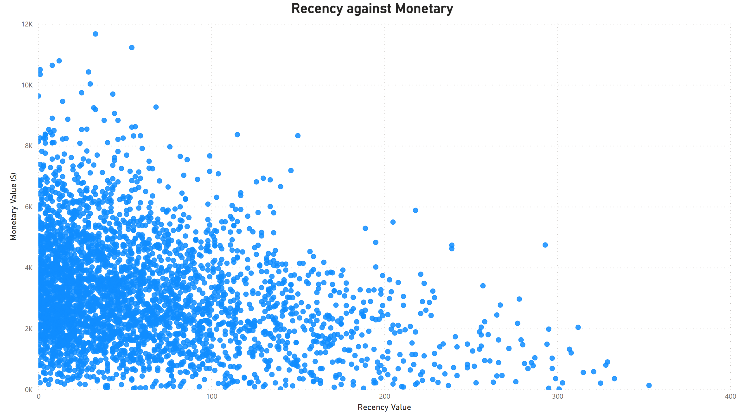
Note: The data and information presented in this document are based on a hypothetical scenario and client. This document is intended solely for the purposes of the KPMG Virtual Internship.
Data Modelling
Scatter plot derived from RFM analysis
Customers with more recent purchases often demonstrate higher monetary value, reflecting stronger loyalty and engagement.
Customers in the top-left quadrant (high recency and high monetary value) are key assets. Businesses should prioritize retaining and engaging this segment.
Customers in the top-right quadrant (high monetary value but low recency) may be at risk of churn. Businesses should focus on reactivating these valuable customers.

Slide 11
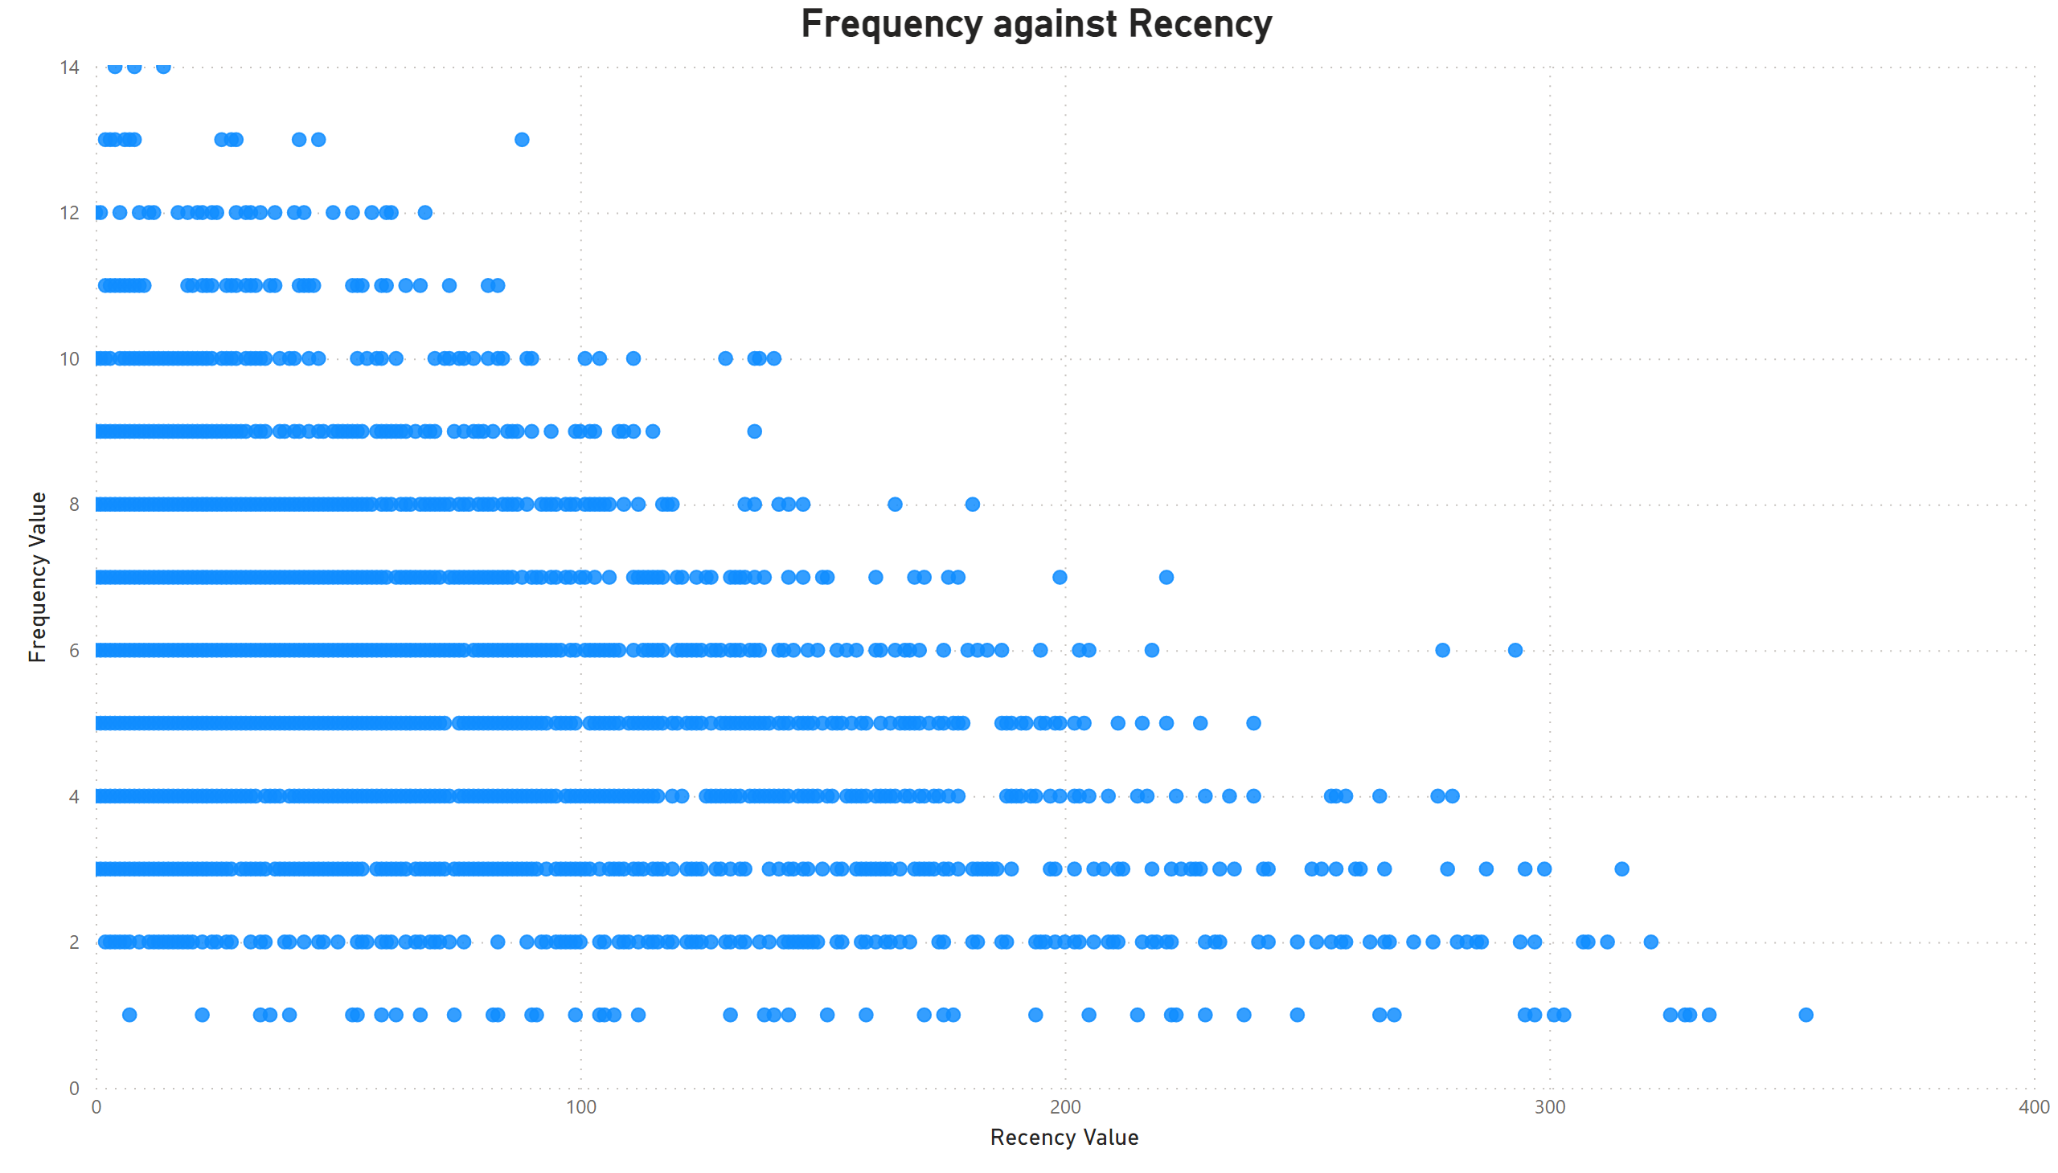
Note: The data and information presented in this document are based on a hypothetical scenario and client. This document is intended solely for the purposes of the KPMG Virtual Internship.
Data Modelling
Scatter plot derived from RFM analysis
Top-Left Quadrant represents highly engaged customers with high frequency and recent transactions. These customers are frequent purchasers and have recently interacted with the business, making them key for retention and loyalty programs.
Bottom-Left Quadrant indicates customers with recent but infrequent transactions, often new or sporadic buyers. This segment offers growth potential, where businesses can focus on targeted engagement strategies to foster loyalty and encourage repeat purchases.

Slide 12
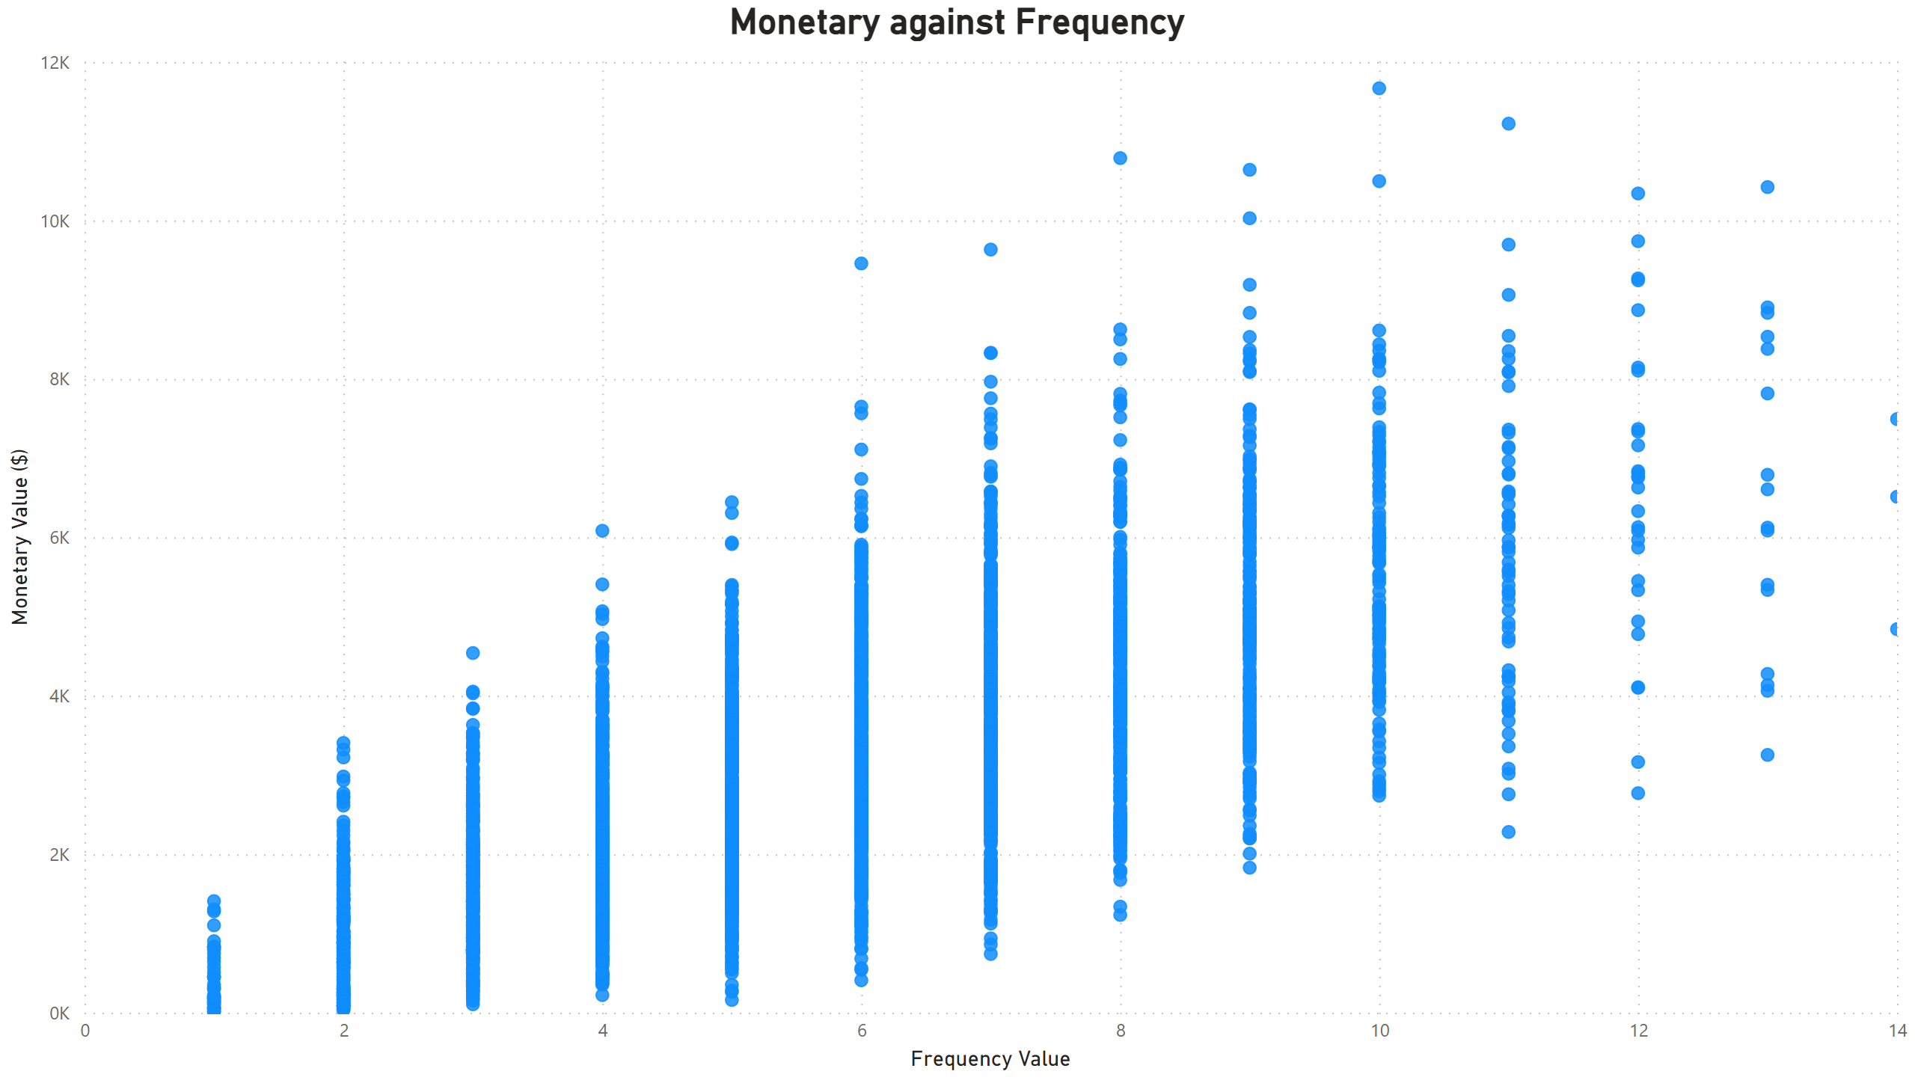
Note: The data and information presented in this document are based on a hypothetical scenario and client. This document is intended solely for the purposes of the KPMG Virtual Internship.
Data Modelling
Scatter plot derived from RFM analysis
Customers with higher purchase frequency often contribute greater monetary value, making them critical to business growth and profitability.
Top-Right Quadrant segment reflects high-frequency, high-spending customers—your most loyal and valuable group. They engage frequently and contribute significantly to revenue. Prioritizing retention and strengthening these relationships is essential.
Top-Left Quadrant segment reflects Customers with high monetary value, but lower frequency offer strong upselling and cross-selling opportunities. Strategic engagement can increase their purchase frequency and unlock additional revenue potential.

Slide 13
Thank you

